Slide 1
    Archdiocese of Milwaukee
Workers Compensation and Management Responsibilities

Slide 2
Agenda
Introduction of United Heartland
Management responsibilities after a workplace injury
  Prompt reporting
  Accident investigation
  Communication
Worker’s compensation loss trending
Return to work / Modified duty
Loss prevention measures

Slide 3
United Heartland
Worker’s compensation carrier since 07/01/2024
Key Contacts
  Cristin Fieber – Senior Claim Representative
  Denise Ferris – Claim Representative
  Tara Junkans – Senior Client Relations Consultant
  Dan Follmer – Senior Loss Control Specialist

Slide 4
Post Accident Process

Slide 5
Archdiocese of Milwaukee
Post Injury Process
Medical Treatment
  If an employee is injured on the job, the priority is to make sure the employee gets the attention needed
Accident Investigation
  Supervisor & Witness Investigation forms
Claim Reporting
  Report Claim timely to United Heartland
  In the case of catastrophic injury or fatality, contact OSHA immediately
  Pharmacy First Fill
United Heartland communication – Expectations
  3-point contact
      Claim adjuster will contact the injured worker, employer contact, and the medical provider within 24 hours
      It is critical that all parties understand the importance of timely communication to ensure that the claim is handled appropriately

Slide 6
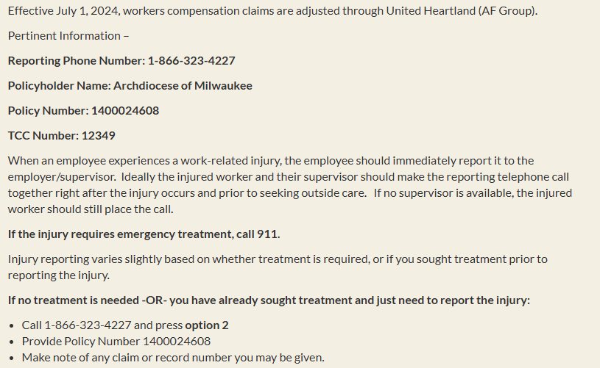
Claim Reporting – TeleCompCare (TCC)
Workers' Compensation Procedures

Slide 7
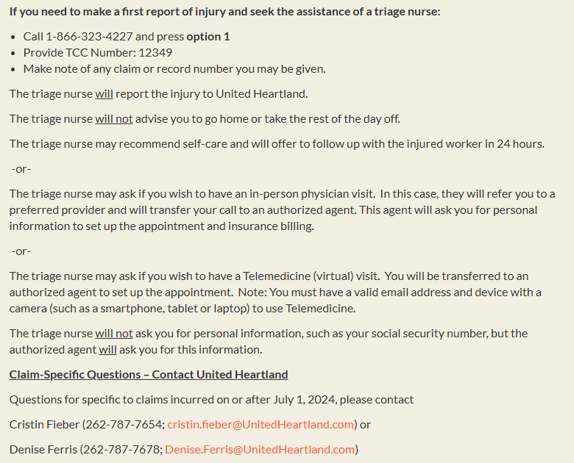
Claim Reporting – TCC (continued)

Slide 8
Archdiocese of Milwaukee
TeleCompCare Statistics (07/01/2024 – 09/18/2025)
Notes:
2024 – 13 of 38 claims reported through TeleCompCare resulted in Self-Care
2025 – 4 of 6 claims reported through TeleCompCare resulted in Self-Care

Slide 9
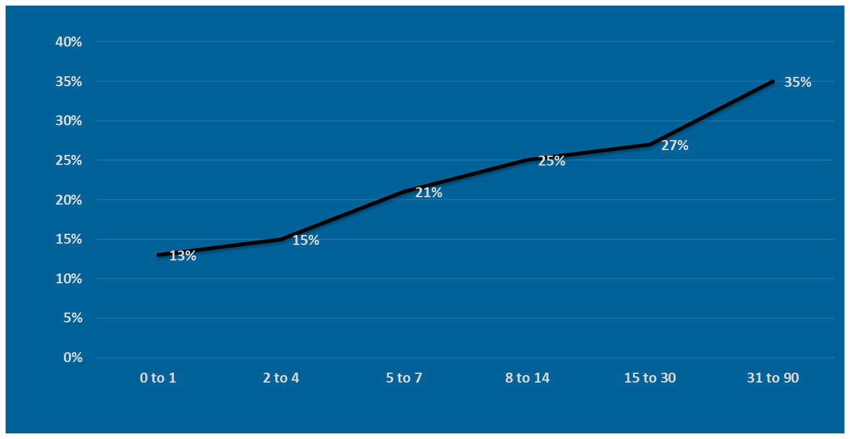
Percent of Claims that Incur Legal Expenses
Claims with Legal Expenses
Days to Report Claim

Slide 10
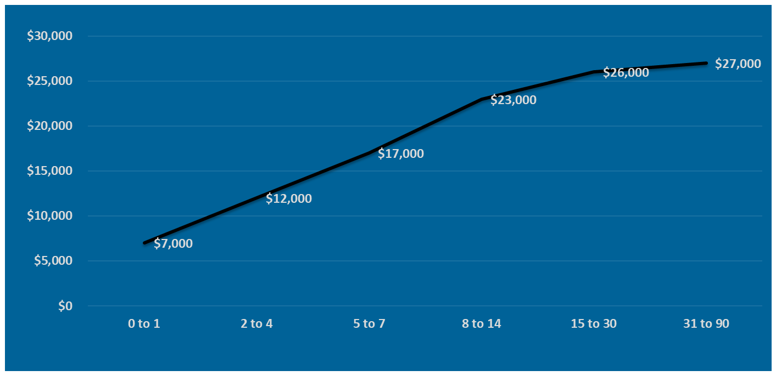
Early Reporting Makes Cents!
Average Paid on Claims
Days to Report Claim

Slide 11
Archdiocese of Milwaukee
Timeliness of Reporting (07/01/2024 – 09/18/2025)

Slide 12
Worker’s Compensation Experience

Slide 13
Archdiocese of Milwaukee
Claim Frequency and Severity by Policy (07/01/2024 – 09/18/2025)

Slide 14
Archdiocese of Milwaukee
Leading Causes of Loss (07/01/2024 – 09/18/2025)
Cause of Loss | Number of Claims | Dollars Incurred
Slip/Trip/Fall | 51 | $504,926
Manual Material Handling | 27 | $67,827
Struck by/Against Object | 19 | $317,156
Cut/Puncture/Scrape | 8 | $1,951
Combative | 3 | $15,984

Slide 15
Archdiocese of Milwaukee
Slip/Trip/Fall Examples
Injured worker states slipped off the ladder and landed on desk.
Injured worker states walking while answering an email on her phone and fell
Injured worker states- twisted ankle on stone and fell into the door
Injured worker states falling tripping over a student.
Injured worker states that the chair they were sitting in broke causing them to fall
Injured worker states- tripped and fell on an uneven surface in the parking lot
Injured worker states fell off ladder
Injured worker states going downstairs, missed step - lost balance and hit head
Injured worker states parked his car got out and slipped on the ice
Injured worker slipped and fell in hallway.
Coming up a step to get to the choir and tripped up the step and/or wiring
EE states he slipped down a grassy incline

Slide 16
Archdiocese of Milwaukee
Manual Material Handling Examples
IW states : twisted knee going upstairs
IW states strained his right arm while lifting.
Playing basketball with a student pulled muscle on left leg
IW was walking up 2 steps by alter and heard a pop in his knee.
EE states he was lifting heavy equipment periodically during his shift
Injured worker states R knee injured.
Injured worker states strain to groin when moving boxes in a closet.
Injured worker states strain to lower back from moving furniture.
IW was lifting salt into the loader.
IW alleges – lifting gravestone to move from one area to another

Slide 17
Archdiocese of Milwaukee
Struck By/Against Object Injury Examples
A student accidentally ran into employee and knocked her over, EE caught herself with her hands.
Injured worker states outside with students near door and student running out of the door ran into the IW and fell on the concrete sidewalk
Injured worker states contusion to R foot from a child jumping and landing on her foot.
Injured worker states kids were kick ball in the classroom and I got hit in the head with the ball.
Injured worker states injured to L side of head, he was putting a cable down into a vault, the cable swung back and hit his head.
Injured worker states that she was playing soccer with the students when the ball hit her in the nose and broke her glasses.
Injured worker states contusion to right foot. IW moving filing cabinet and it fell on her foot.

Slide 18
Archdiocese of Milwaukee
Claim Activity by Age Demographics (07/01/2024 – 09/18/2025)
Age Group | Number of Claims | Dollars Incurred | Average Dollars Incurred
60+ | 35 | $692,817 | $19,795
51-60 | 34 | $101,412 | $2,983
41-50 | 23 | $90,820 | $3,949
31-40 | 18 | $28,745 | $1,597
18-30 | 21 | $31,616 | $1,506

Slide 19
Worker’s Compensation Insurance

Slide 20
Archdiocese of Milwaukee
Workers Compensation Premium
How much do we pay for workers compensation insurance premium ?
A) $250,000
B) $500,000
C) $1,000,000
D) $2,000,000

Slide 21

Workers Compensation
How is this premium determined?
Three Determinants:
  How hazardous the jobs are in your industry (rates)
  Payroll figures
  Past loss experience (Experience Modification Rate)

Slide 22
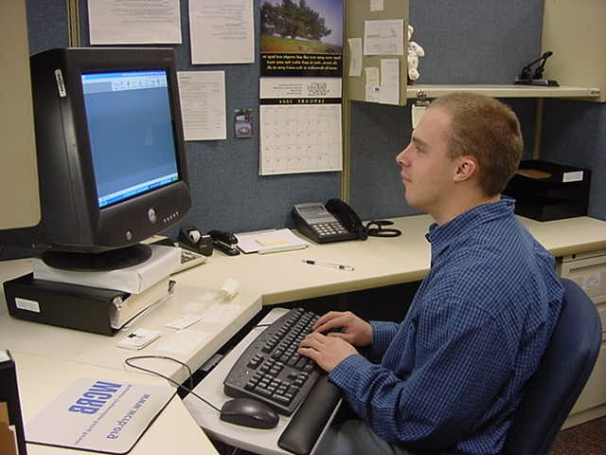
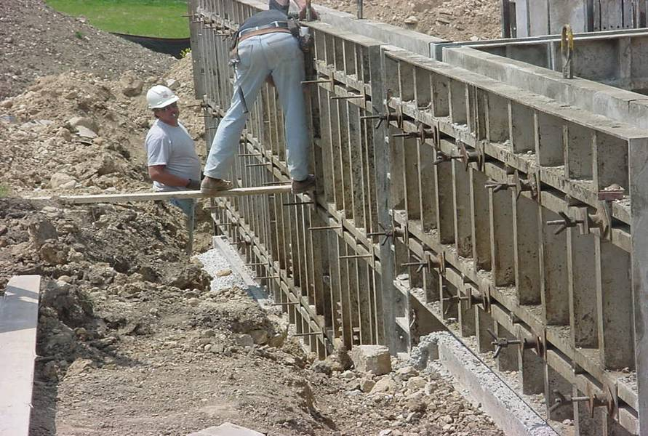
How hazardous the jobs are within your industry?
Vs

Slide 23

Experience Modification Rate
What is it?
Indication of how an organization has performed compared to like industries over the last three years
Goal – be less than 1.00 (credit modifier)
Uses 3 years of past history
  Takes 3 years to do/undo
  Primary goal is to control
    As an employee, you’re unable to control the rates.
    You’re unable to control the numbers of employees working for the organization (payroll).

Slide 24
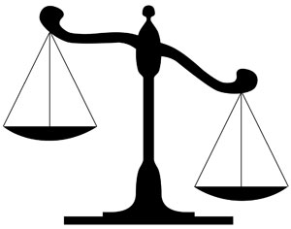
Experience Modification System
An employer’s actual experience modification is determined based on how WC claims compare to expected claim costs.
Expected claim costs are based on your anticipated payroll and the historic loss rate for all employers in a given class.
An experience modification is a percentage which your current workers’ compensation premium is modified up or down, based on your “experience.”
Expected Losses
Actual Losses

Slide 25
Archdiocese of Milwaukee
Actual versus Expected Results – 2025 Policy Period
Archdiocese of Milwaukee: 1.46

Slide 26
Indemnity Claim Impact on the EMR
Indemnity claims (lost time or permanent disability) go into the formula at 100% of the claim value
Medical only claims are reduced by 70%!
Modified duty/return to work efforts are second only to loss prevention in trying to control the cost of worker’s compensation premiums.

Slide 27
Archdiocese of Milwaukee
Losses by Claim Type (07/01/2024 – 09/18/2025)

Slide 28
Return to Work / Modified Duty
Financial Advantages
Modified duty is second only to not having injuries in reducing long-term insurance costs. It is the quickest way to return an employee to full earning capacity.
Studies have proven that modified duty reduces extended medical costs, primarily because it is often therapeutic and speeds recovery.
The program allows the employer and insurer to establish communications with the medical community and helps avoid extended or weak treatment plans that cost you money.
Court rulings have shown that effective and well-defined policies avoid legal confrontations and associated legal fees.
Personnel Advantages
An injured employee’s desire to return to work is directly proportional to the length of time away from work.
Employees can be utilized to do jobs/tasks that need to be done, but which may not be of immediate priority.
It keeps an employee on his or her “biological work clock”.
Modified duty prevents employees from becoming dependent on a disability system.
It prevents employees from using the workers compensation system as a vacation supplement.
It ensures that employees and employers stay in visual and verbal contact. Loss of contact means loss

Slide 29
Loss Prevention

Slide 30
Loss Prevention - Slips/Trips/Falls
Loss Prevention:
  Choose the correct footwear for the situation
  Avoid distractions
  Minimize how much you carry; use carts or rolling bags for those who need carry things
  Choosing the correct route (don’t take shortcuts)
  3 points of contact when entering/exiting a vehicle
  Choose the correct ladder for the job when working at elevation
  Walk like a penguin during winter weather conditions
  Alert others of potential hazards

Slide 31
Loss Prevention – Material Handling
Know your limitations
Ask for help where needed
Use the correct tools for the job

Slide 32
United Heartland Loss Control Services
Training opportunities
Assist with accident investigations
Site surveys
  Evaluate conditions and activities from a safety perspective
  Slip/trip/fall evaluations
Resources available:
  Training material
  Sample programs

Slide 33
Thank you for your time and attention!

