Slide 1

Are You The Weakest Link? (to your Networks security)
Dale Klein
Information System Specialist
Archdiocese of Milwaukee(MMCPC)
kleind@archmil.org

Slide 2
Outline
Cyber Security Terminology
A Look at some Cybercrime activity
Emails (Identifying the Red Flags)
Example emails
Incident Response (I’ve been Hooked, now what?)
Examples of poor password choices
Password Managers
Helpful links

Slide 3
Cyber Security Terminology
Social Engineering - the art of manipulating, influencing, or deceiving you in order to get something of value.
Phishing - the process of attempting to acquire sensitive information such as usernames, passwords, and credit card details by masquerading as a trustworthy entity. Uses bulk email.
Social Website
Bank
IT administrators

Slide 4
Spear Phishing
A small, focused, targeted attack using email on a particular person or organization with the goal to penetrate their defenses. Also known as CEO fraud.
SMiShing | SMS/MMS texts
Vishing | phone calls/voice messages
Ransomware
Ransomware is a type of malware that prevents or limits access to a system or network by encrypting files on the system. They require a payment (in bitcoins) in order to get the encryption key to unlock the files.

Slide 5
A Look at some Cybercrime activity
Email phishing is a top threat to organizations because it works so well. Represents 93% of breaches – Verizon DBIR
This makes the everyday user the last line of defense.
Ransomware attacks are growing more than 360% annually. – CISCO
According to EmsiSoft, the first nine months of 2019 saw ransomware attacks against 621 government entities; healthcare service providers; and school districts, colleges and universities- that number includes at least 62 educational institution incidents involving more than 1,000 individual schools.
2019 MidYear QuickView Data Breach Report - the first six months saw more than 3,800 publicly disclosed breaches exposing an incredible 4.1 billion compromised records.
149 of 3800 breaches accounts for 3.2 BILLION of the records.
Email addresses (70 percent)
Passwords (65 percent)

Slide 6
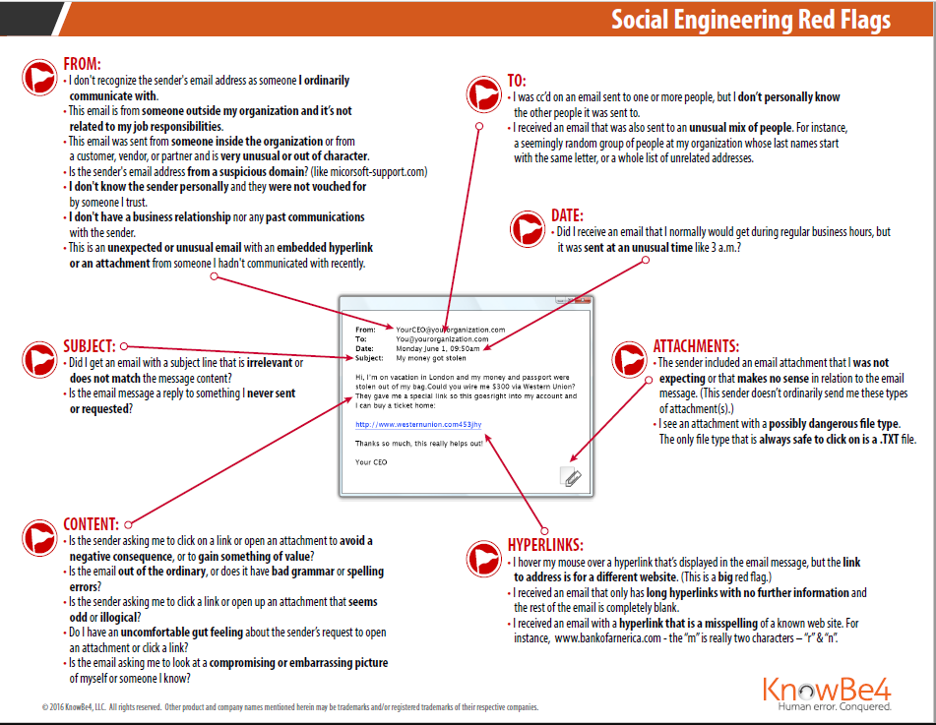

Slide 7
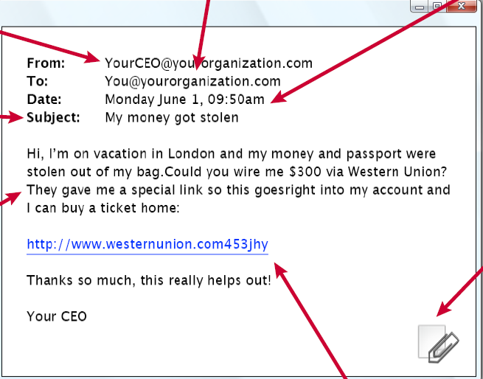

Slide 8
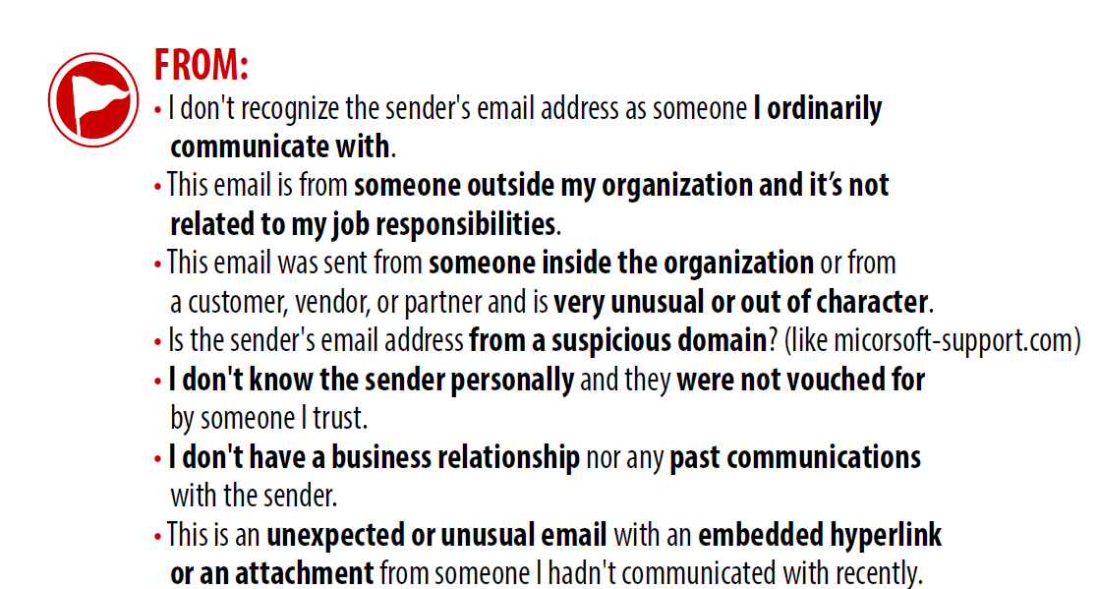

Slide 10
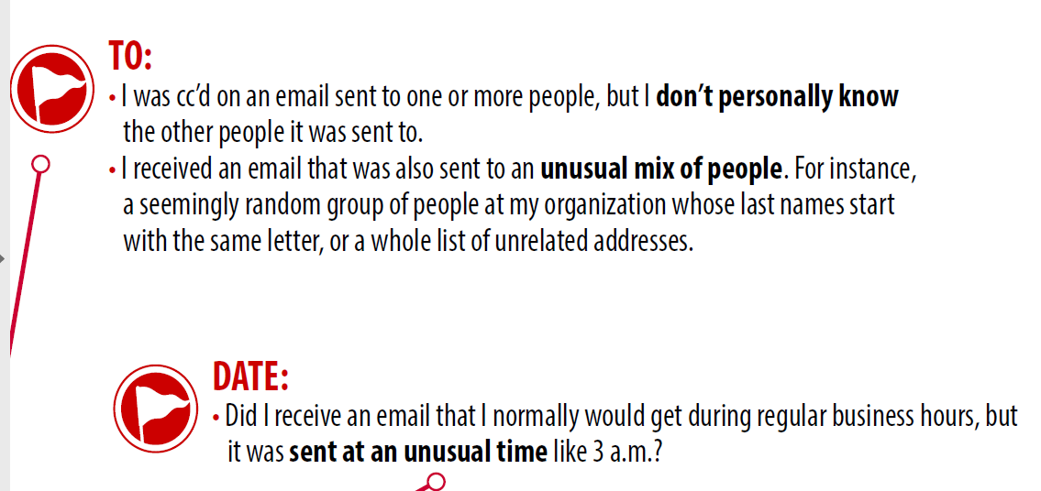
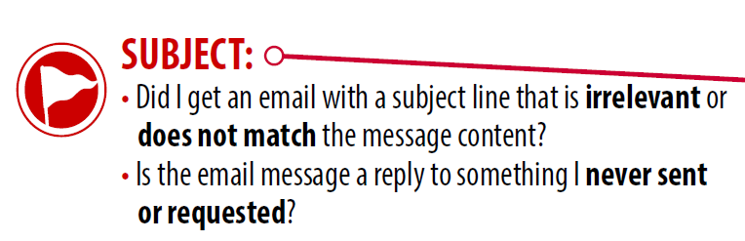

Slide 12
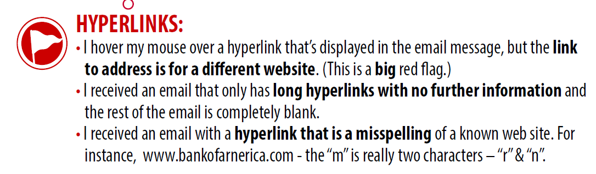
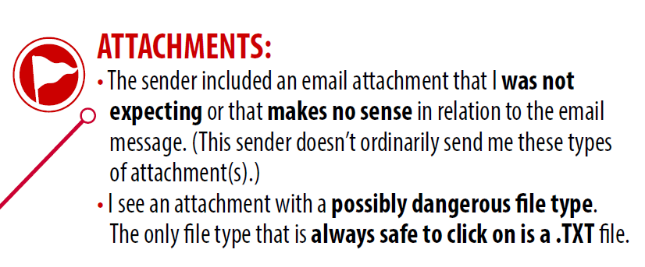

Slide 13
Example Emails

Slide 14
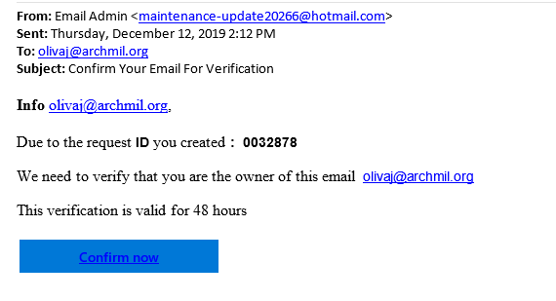

Slide 15



Slide 16
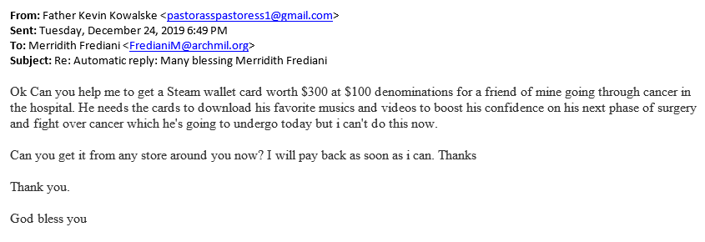

Slide 17
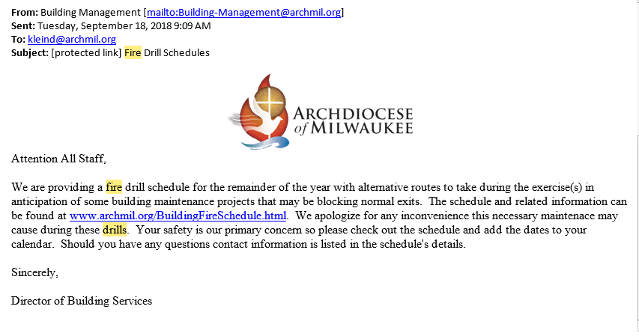
https://singlesignon.secured-login.net/pages/8bf720728b56/XcmVIjaXBpZWr50X2lkPTPM4MjcwcxNTU1aMSZjYW1wlYWhlnbl9ydW5faWQ9MTQ4PNjI0OCZhY3Rpb249Y2xpY2smdXJsPWh0dHBzOi8vc2luZ2xlc2lnbm9uLnNlY3VyZWQtbG9naW4ubmV0L3BhZ2VzLzhiZjcyMDcyOGI1Ng==

Slide 18
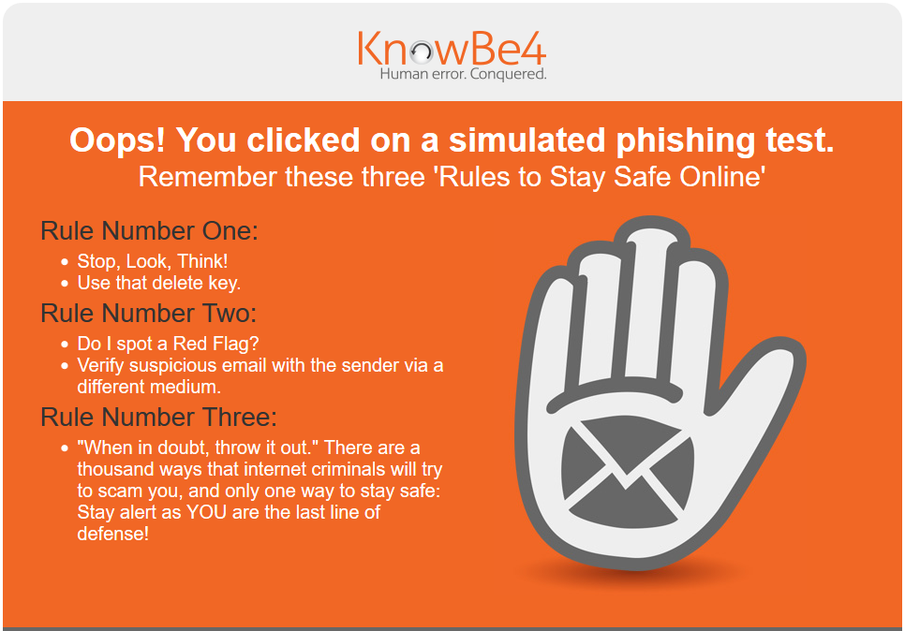

Slide 19
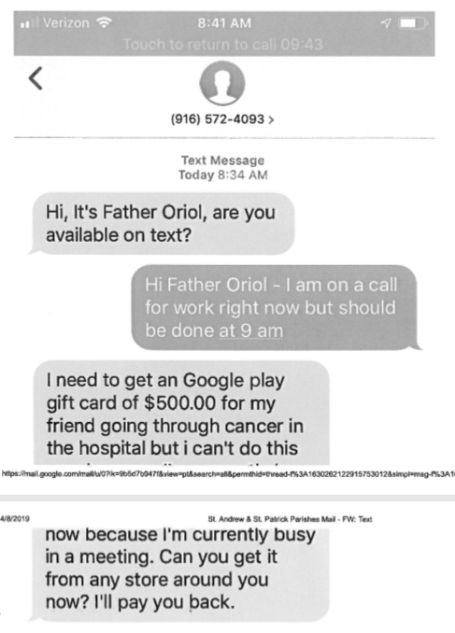

Slide 20
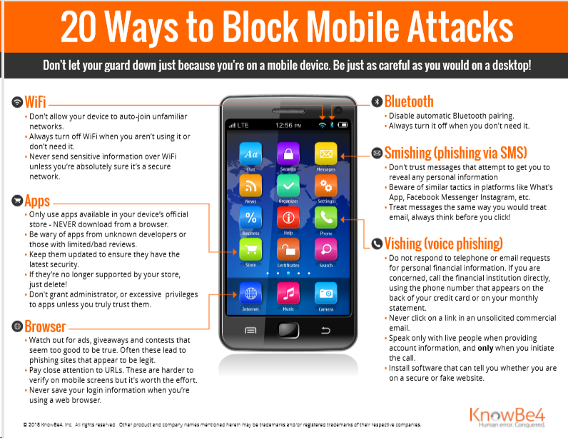

Slide 21

I’ve been Hooked, now what?

Slide 22
Examples of poor password choices
Top 10 passwords for 2019
123456
123456789
qwerty
12345678
111111
1234567890
1234567
password
123123
987654321

Slide 23
Password Managers
Trouble remembering passwords?
Try a Password Manager such as LastPass.
Save all your usernames and passwords to a Password Manager.
With a Password Manager managing your logins, it’s easy to have a strong, unique password for every online account and improve your online security.
Variety in passwords:
Never use the same password everywhere. Cyber criminals will attempt to use them on all of your accounts because people commonly employ this easy-to-remember practice.

Slide 24
You create a password manager account with an email address and a strong master password to locally-generate a unique encryption key.
Your data is encrypted and decrypted at the device level. Data stored in your vault is kept secret, even from LastPass. Your master password, and the keys used to encrypt and decrypt data, are never sent to LastPass’ servers, and are never accessible by LastPass.

Slide 25
Have I Been Pwned website (gloating expression of dominances)
Troy Hunt - a Microsoft Regional Director
Most Valuable Professional awardee for Developer Security
Blogger at troyhunt.com, international speaker on web security
https://haveibeenpwned.com/
Check if you have an account that has been compromised in a data breach
https://haveibeenpwned.com/Passwords
“Pwned Passwords are 555,278,657 real world passwords previously exposed in data breaches. This exposure makes them unsuitable for ongoing use as they're at much greater risk of being used to take over other accounts. They're searchable online, as well as being downloadable, for use in other online systems.”

Slide 26
Knowbe4.com/what-is-social-engineering/#6
(tip sheets are three quarters down on the page)
10 tips for spotting a phishing email
How to Spot a Phishing Email or Fake Landing Page
How to Identify a Phishing or Spoofing Email
The best password managers of 2019
Spotting Phishing Emails (video)
Identifying Phishing Emails (video)
Phishing Attack Example - How to Spot a Scam Email (video)

