Slide 1
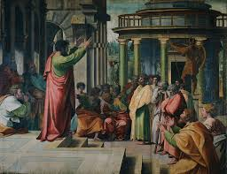
Session 4: Early Christian Dynamic Homilies
Motivating the early Christian congregations

Slide 2
Early Christian Dynamic Homilies
Questions for Theological Reflection
Which of your homilies get the best reviews?
What makes for a good homily, in your view?
Which homilies are most challenging for you to preach?

Slide 3
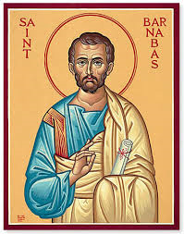
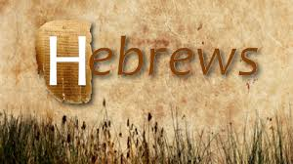
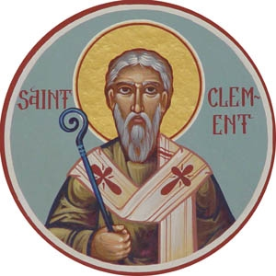
Early Christian Dynamic Homilies
New Testament Sources:
The Book of Hebrews
Apostolic Fathers Sources:
Epistle of Barnabas
Second Clement

Slide 4
Early Christian Dynamic Homilies
Hebrews shames his congregation
into discerning a deeper
understanding of Christ.
Epistle of Barnabas preys upon the
prejudices and fears many
Christians held about Jews.
Second Clement diffuses the
ongoing debate between faith
and good works by focusing on
reciprocity to God for Christ.

Slide 5
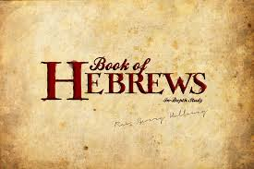
Early Christian Dynamic Homilies
Setting the Context
.

Slide 6

Interesting facts about the Book of Hebrews
It is the only NT writing that has no claim to authorship.
Its Christology is completely unique in the NT.
Its manuscript tradition is quite odd.
.

Slide 7

The historical setting of the Book of Hebrews
The author of Hebrews is unknown
and there is no claim to author –
unique in the NT!
The intended audience is almost certainly Jewish Christians with a good knowledge of even less prominent Old Testament characters, such as Melchizidek.
This homily is plausible datable from 60-90 CE.
Heb 13:24 is the clue for place of composition: “Greetings to all your leaders and to all the holy ones. Those from Italy send you greetings.” This suggests the writing was composed in Italy – quite possibly, Rome.

Slide 8
Early Christian Dynamic Homilies
Why was Hebrews remembered?
How did it motivate early believers?
.

Slide 9
Hebrews: responding to “sluggish” believers
The homilist of Hebrews is clearly agitated by the community’s apparent apathy and disinterest:
“You have become sluggish…although you should be
teachers by this time, you need to have someone teach you
again the basic elements of the utterances of God.” – 5:11-12
The homilist is openly critical of the congregations’ behavior:
It does not assemble as a community anymore (10:25).
It is not upholding its original confession of faith (4:14; 10:23).
It not only needs to hear the fundamentals of the faith again, but also reflect further on the Christian message (5:12-6:2).
This chastisement sets the stage for Hebrews’ remarkable Christology.
.

Slide 10
Hebrews: responding to “sluggish” believers
The Hebrews’ homilist invites his congregation to serious discernment:
“Therefore, let us leave behind the basic teaching of
Christ and advance to maturity, without laying the
foundation all over again.” – 6:1
2 examples of “mature” theology – read every Good Friday as the 2nd reading
“Therefore, since we have a great high priest who has passed through the heavens, Jesus, the Son of God, let us hold fast to our confession. For we do not have a high priest who is unsympathetic with our weaknesses, but one who has been similarly tested in every way, yet without sin.” – 4:14-15
“Son though he was, he learned obedience from what he had suffered, and when he was made perfect, he became the source of eternal salvation for all who obey him.” - 5:8-9
.

Slide 11
Early Christian Dynamic Homilies
Questions for Theological Reflection
Which of your homilies get the best reviews?
What makes for a good homily, in your view?
Which homilies are most challenging for you to preach?

