Slide 1
Called to Leadership:
A Biblical Perspective

Slide 2

The Charism and Call to Leadership
Leaders act as God’s catalysts
Leaders operate as problem-discoverers
Leaders communicate a compelling vision of a better future

Slide 3
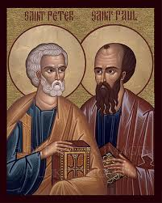
Saint Peter and Saint Paul as Leaders in the Early Church

Slide 4
The call of Saint Peter (Luke 5:1-11)
While the crowd was pressing in on Jesus and listening to the word of God, he was standing by the Lake of Gennesaret. He saw two boats there alongside the lake; the fishermen had disembarked and were washing their nets. Getting into one of the boats, the one belonging to Simon, he asked him to put out a short distance from the shore. Then he sat down and taught the crowds from the boat. After he had finished speaking, he said to Simon, “Put out into deep water and lower your nets for a catch.” Simon said in reply, “Master, we have worked hard all night and have caught nothing, but at your command I will lower the nets.” When they had done this, they caught a great number of fish and their nets were tearing. They signaled to their partners in the other boat to come to help them. They came and filled both boats so that they were in danger of sinking. When Simon Peter saw this, he fell at the knees of Jesus and said, “Depart from me, Lord, for I am a sinful man.” For astonishment at the catch of fish they had made seized him and all those with him, and likewise James and John, the sons of Zebedee, who were partners of Simon. Jesus said to Simon, “Do not be afraid; from now on you will be catching men.” When they brought their boats to the shore, they left everything and followed him.

Slide 5
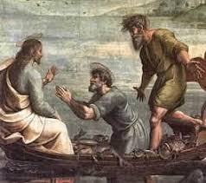
The call of Saint Peter (Luke 5:1-11)
The divine encounter
and commission:
“Do not be afraid; from now on you will be catching men.”

Slide 6
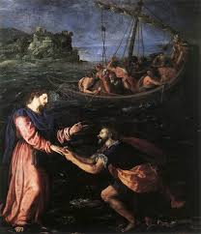
The call of Saint Peter (Luke 5:1-11)
Peter’s spiritual
frame of mind:
Jesus encounters Peter at Peter’s most intimate level: fear and humility

Slide 7
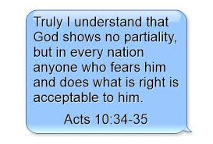
The call of Saint Peter (Luke 5:1-11)
Defining moments in Peter’s leadership:
Luke 5:1-11: the call of Peter
Acts 5:17-42: Trial before the Sanhedrin
Acts 10:1-49: Peter and Cornelius
Acts 15:1-35: The Council of Jerusalem

Slide 8
The call of Saint Paul (Galatians 1:11-24)
Now I want you to know, brothers, that the gospel preached by me is not of human origin. For I did not receive it from a human being, nor was I taught it, but it came through a revelation of Jesus Christ. For you heard of my former way of life in Judaism, how I persecuted the church of God beyond measure and tried to destroy it, and progressed in Judaism beyond many of my contemporaries among my race, since I was even more a zealot for my ancestral traditions. But when [God], who from my mother’s womb had set me apart and called me through his grace, was pleased to reveal his Son to me, so that I might proclaim him to the Gentiles, I did not immediately consult flesh and blood, nor did I go up to Jerusalem to those who were apostles before me; rather, I went into Arabia and then returned to Damascus. Then after three years, I went up to Jerusalem to confer with Cephas and remained with him for fifteen days. But I did not see any other of the apostles, only James the brother of the Lord. (As to what I am writing to you, behold, before God, I am not lying.) Then I went into the regions of Syria and Cilicia. And I was unknown personally to the churches of Judea that are in Christ; they only kept hearing that “the one who once was persecuting us is now preaching the faith he once tried to destroy.” So they glorified God because of me.

Slide 9
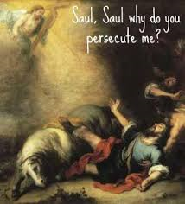
The call of Saint Paul (Galatians 1:11-24)
The divine encounter
and commission:
But when [God], who from my mother’s womb had set me apart and called me through his grace, was pleased to reveal his Son to me, so that I might proclaim him to the Gentiles.

Slide 10
The call of Saint Paul (Gal 1:11-24)
Paul’s spiritual
frame of mind:
Jesus encounters Paul at Paul’s most intimate level: arrogance and anger

Slide 11
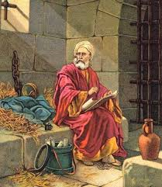
The call of Saint Paul (Gal 1:11-24)
Defining moments in Paul’s leadership:
Gal 1:11-24: the call of Paul
Acts 15:1-35: the Council of Jerusalem
Romans 1:16-17: Paul’s gospel
Acts 28:11-31: Paul under house arrest in Rome

Slide 12
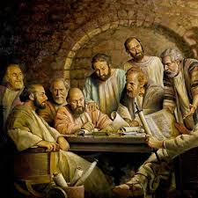
The Council of Jerusalem (Acts 15:1-35) – the vision of a better future
The Council of Jerusalem convened in 48 AD – 15 years after the call of Paul.
The early Church faced a schism among its Jewish and Gentile believers.
It was a true existential moment.
The Church relies on its trust in the Holy Spirit.

Slide 13
The Call to Leadership in the world today 5 Biblical Takeaways
God calls us to leadership from the complexities of our lives.
Effective leaders are grounded in an intimacy with the Lord.
Leaders bring others to encounter Jesus Christ.
Leaders are role models of discipleship.
Leaders trust the work of the Holy Spirit.

Slide 14
Called to Leadership:
A Biblical Perspective

